Slide 1

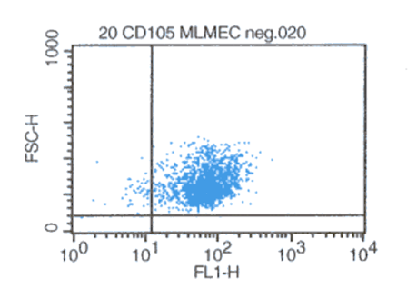
ReliaTech GmbH
Rat anti-mouse CD105/Endoglin
(Cat #103-M60)
Fig. 1: FACS analysis with primary mouse lung microvascular endothelial cells (MLMEC).
http://www.reliatech.de / orders@reliatech.de

